Slide 1
LY TU TRONG COLLEGE
ENGLISH DEPARTMENT
Teacher’s name:
VÕ THỊ HỒNG LAN

Slide 2
UNIT 2A
AMERICAN ENGLISH FILES 2
RIGHT PLACE - WRONG PERSON
2. READING AND SPEAKING
Page 15

Slide 3
READ IN PAIRS
STUDENT A
STUDENT B
JOE’S VACATION
LAURA’S VACATION

Slide 4
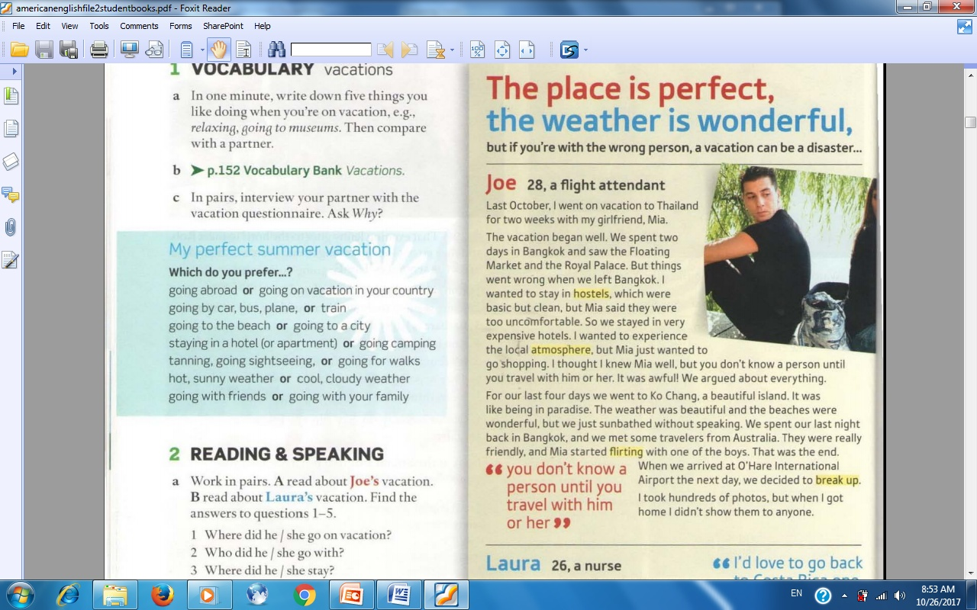
LISTEN TO
THE TAPE
STUDENT A
JOE’S VACATION

Slide 5
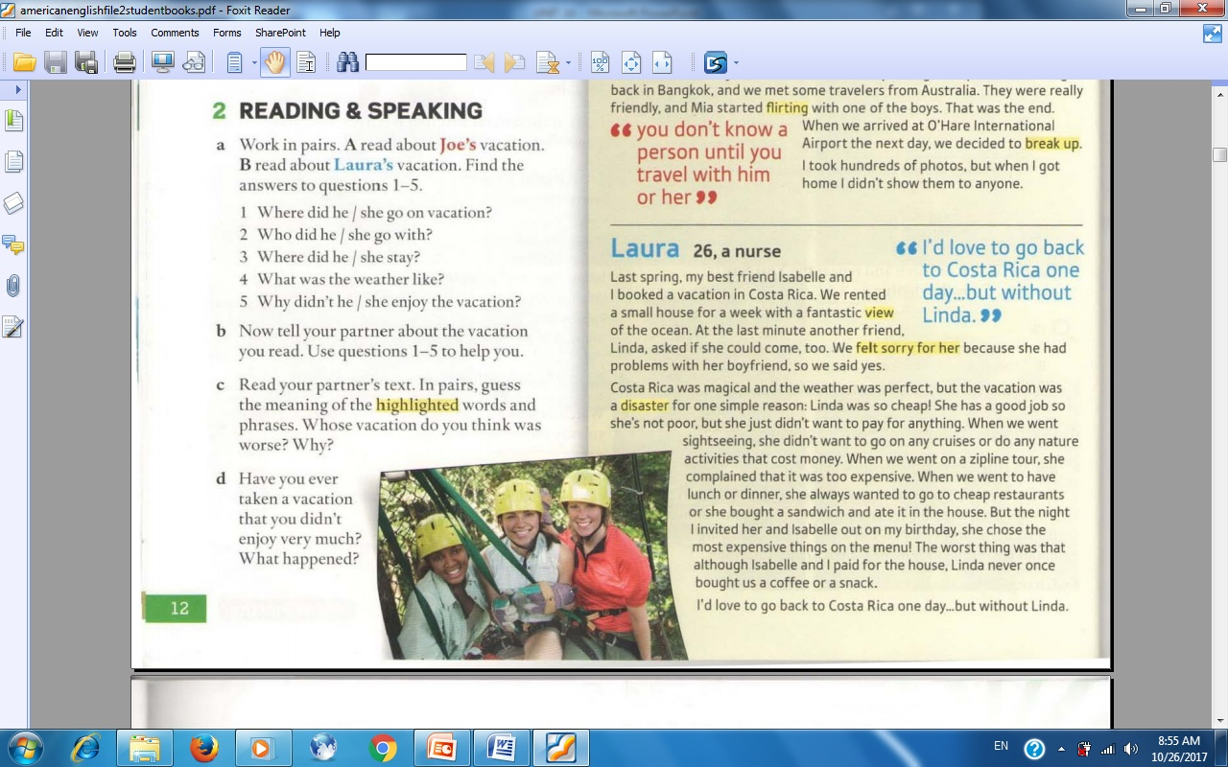
LISTEN TO
THE TAPE
STUDENT B
LAURA’S VACATION

Slide 6
I. FILL IN THE TABLE ABOUT JOE’S VACATION.
STUDENT A
COUNTRY? | GO WITH? | STAY IN? | WEATHER? | WHY NOT ENJOY?
THAILAND

Slide 7
I. FILL IN THE TABLE ABOUT JOE’S VACATION.
STUDENT A
COUNTRY? | GO WITH? | STAY IN? | WEATHER? | WHY NOT ENJOY?
THAILAND
GIRLFRIEND

Slide 8
I. FILL IN THE TABLE ABOUT JOE’S VACATION.
STUDENT A
COUNTRY? | GO WITH? | STAY IN? | WEATHER? | WHY NOT ENJOY?
THAILAND
GIRLFRIEND
EXPENSIVE HOTELS

Slide 9
I. FILL IN THE TABLE ABOUT JOE’S VACATION.
STUDENT A
COUNTRY? | GO WITH? | STAY IN? | WEATHER? | WHY NOT ENJOY?
THAILAND
GIRLFRIEND
EXPENSIVE HOTELS
BEAUTIFUL

Slide 10
I. FILL IN THE TABLE ABOUT JOE’S VACATION.
STUDENT A
COUNTRY? | GO WITH? | STAY IN? | WEATHER? | WHY NOT ENJOY?
THAILAND
GIRLFRIEND
EXPENSIVE HOTELS
BEAUTIFUL
NOT KNOW MIA WELL

Slide 11
I. FILL IN THE TABLE ABOUT LAURA’S VACATION.
STUDENT B
COUNTRY? | GO WITH? | STAY IN? | WEATHER? | WHY NOT ENJOY?
COSTA RICA

Slide 12
III. FILL IN THE TABLE ABOUT LAURA’S VACATION.
STUDENT B
COUNTRY? | GO WITH? | STAY IN? | WEATHER? | WHY NOT ENJOY?
COSTA RICA
2 FRIENDS

Slide 13
III. FILL IN THE TABLE ABOUT LAURA’S VACATION.
STUDENT B
COUNTRY? | GO WITH? | STAY IN? | WEATHER? | WHY NOT ENJOY?
COSTA RICA
2 FRIENDS
SMALL HOUSE

Slide 14
III. FILL IN THE TABLE ABOUT LAURA’S VACATION.
STUDENT B
COUNTRY? | GO WITH? | STAY IN? | WEATHER? | WHY NOT ENJOY?
COSTA RICA
2 FRIENDS
SMALL HOUSE
PERFECT

Slide 15
III. FILL IN THE TABLE ABOUT LAURA’S VACATION.
STUDENT B
COUNTRY? | GO WITH? | STAY IN? | WEATHER? | WHY NOT ENJOY?
COSTA RICA
2 FRIENDS
SMALL HOUSE
PERFECT
LINDA WAS CHEAP.

Slide 16
II. ANSWER THE QUESTIONS
ABOUT JOE’S VACATION.
STUDENT A
1.Where did Joe go on vacation?
2. Who did he go with?
3. Where did he stay?
4. What was the weather like?
5. Why didn’t he enjoy the vacation?
He went to Thailand.
He went with his girlfriend, Mia.
He stayed in expensive hotels.
The weather was beautiful.
Because he didn’t know Mia well.

Slide 17
II. ANSWER THE QUESTIONS
ABOUT LAURA’S VACATION.
STUDENT B
1.Where did Laura go on vacation?
2. Who did she go with?
3. Where did she stay?
4. What was the weather like?
5. Why didn’t she enjoy the vacation?
She went to Costa Rica.
She went with 2 friends.
She stayed in a small house.
The weather was perfect.
Because Linda was so cheap.

Slide 18
III. WORK IN PAIRS (SPEAKING)
STUDENT A
STUDENT B
JOE’S VACATION
LAURA’S VACATION
USE THE ANSWERS ABOVE

Slide 19
SPEAKING
STUDENT A
JOE’S VACATION

Slide 20
SPEAKING
STUDENT B
LAURA’S VACATION

Slide 21
IV. READ IN PAIRS
STUDENT A
STUDENT B
JOE’S VACATION
LAURA’S VACATION
GUESS THE MEANING OF THE HIGHLIGHTED WORDS AND PHRASES

Slide 22
GUESS THE MEANING OF THE HIGHLIGHTED WORDS AND PHRASES

Slide 23
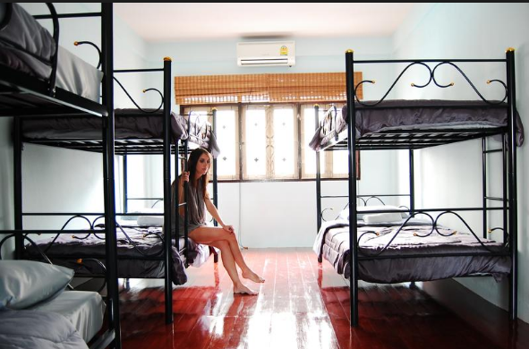
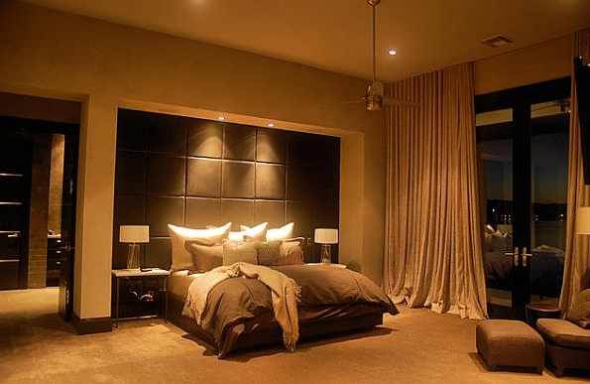
HOSTEL
HOTEL

Slide 24
GUESS THE MEANING OF THE HIGHLIGHTED WORDS AND PHRASES
HOSTEL
NHÀ TRỌ RẺ TIỀN

Slide 25
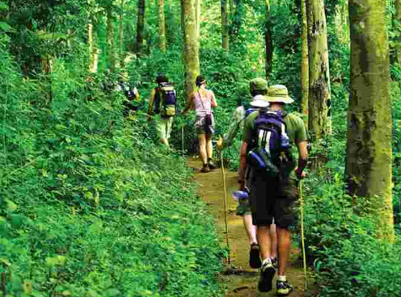
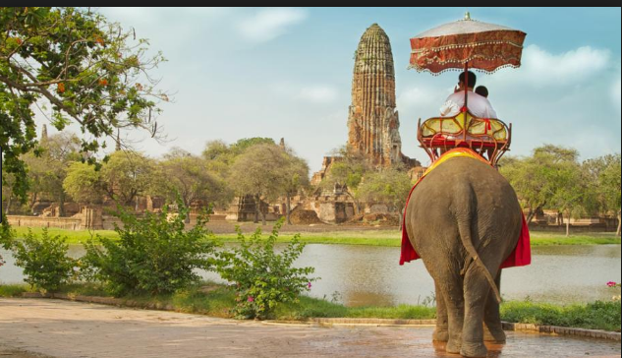
LOCAL ATMOSPHERE

Slide 26
GUESS THE MEANING OF THE HIGHLIGHTED WORDS AND PHRASES
HOSTEL
NHÀ TRỌ RẺ TIỀN
ATMOSPHERE
KHÔNG KHÍ

Slide 27
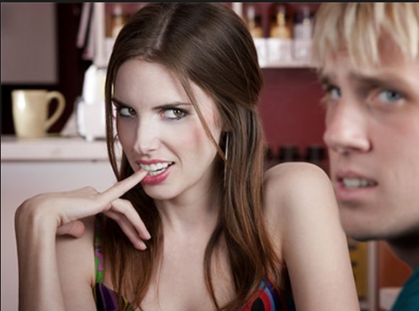
FLIRTING

Slide 28
GUESS THE MEANING OF THE HIGHLIGHTED WORDS AND PHRASES
HOSTEL
NHÀ TRỌ RẺ TIỀN
ATMOSPHERE
KHÔNG KHÍ
FLIRTING
TÁN TỈNH

Slide 29
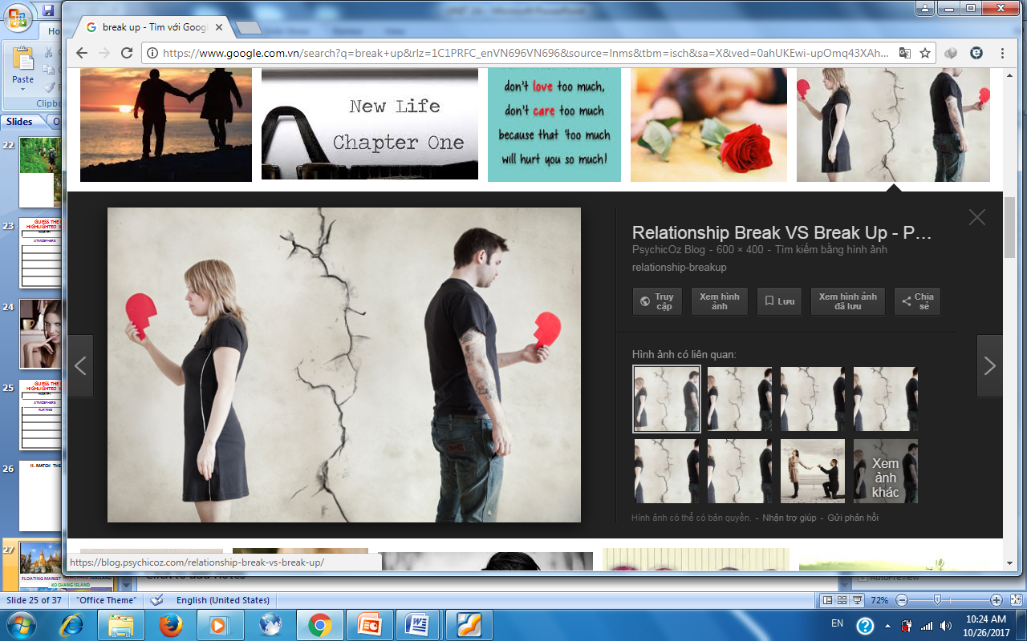
BREAK UP

Slide 30
GUESS THE MEANING OF THE HIGHLIGHTED WORDS AND PHRASES
HOSTEL
NHÀ TRỌ RẺ TIỀN
ATMOSPHERE
KHÔNG KHÍ
FLIRTING
TÁN TỈNH
BREAK UP
CHIA TAY

Slide 31
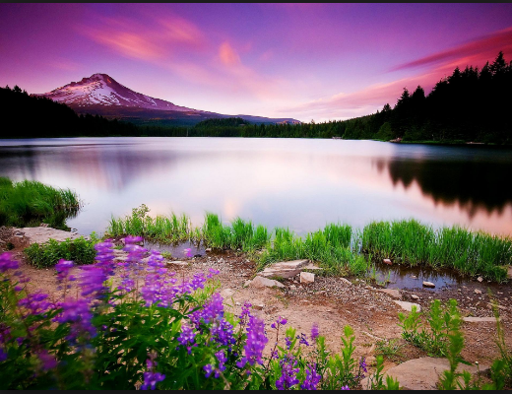
FANTASTIC VIEW

Slide 32
GUESS THE MEANING OF THE HIGHLIGHTED WORDS AND PHRASES
HOSTEL
NHÀ TRỌ RẺ TIỀN
ATMOSPHERE
KHÔNG KHÍ
FLIRTING
TÁN TỈNH
BREAK UP
CHIA TAY
VIEW
QUANG CẢNH

Slide 33
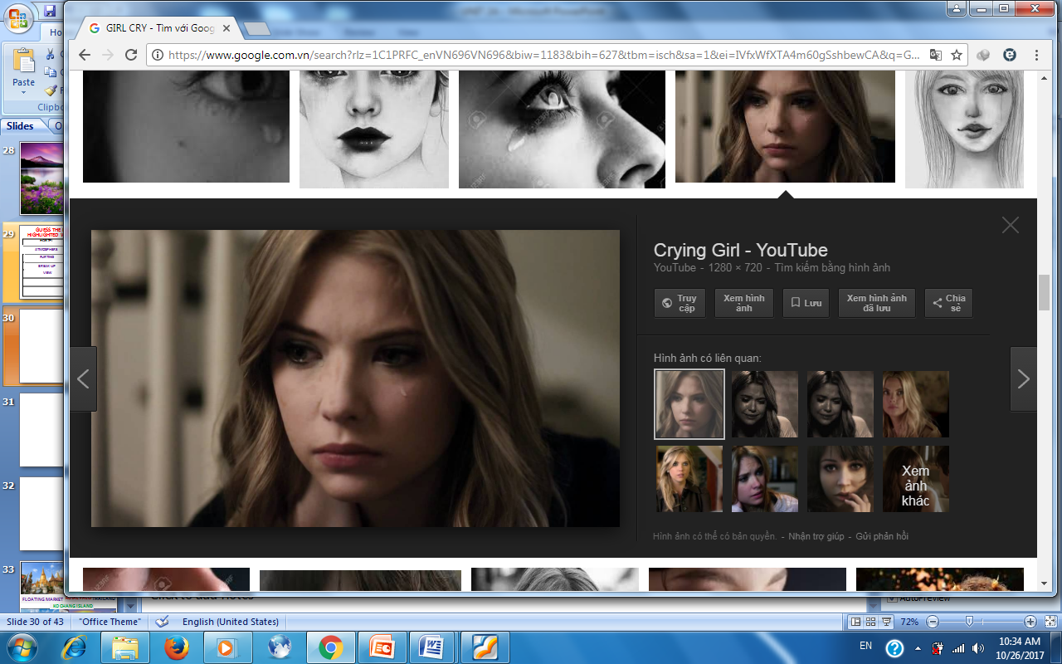
FELT SORRY FOR HER

Slide 34
GUESS THE MEANING OF THE HIGHLIGHTED WORDS AND PHRASES
HOSTEL
NHÀ TRỌ RẺ TIỀN
ATMOSPHERE
KHÔNG KHÍ
FLIRTING
TÁN TỈNH
BREAK UP
CHIA TAY
VIEW
QUANG CẢNH
FELT SORRY FOR HER
CẢM THẤY TỘI NGHIỆP CÔ ẤY

Slide 35
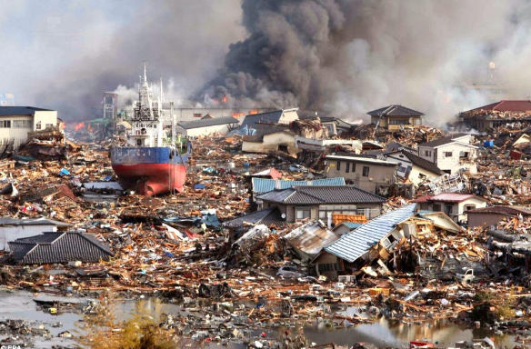
NATURAL DISASTER

Slide 36
GUESS THE MEANING OF THE HIGHLIGHTED WORDS AND PHRASES
HOSTEL
NHÀ TRỌ RẺ TIỀN
ATMOSPHERE
KHÔNG KHÍ
FLIRTING
TÁN TỈNH
BREAK UP
CHIA TAY
VIEW
QUANG CẢNH
FELT SORRY FOR HER
CẢM THẤY TỘI NGHIỆP CÔ ẤY
DISASTER
THẢM HOẠ

Slide 37
V. SPEAKING
1. WHOSE VACATION DO YOU THINK WAS WORSE? WHY?
BREAK UP

Slide 38
V. SPEAKING
2. WHERE DID YOU GO ON VACATION?
3. WHO DID YOU GO WITH?
4. WHERE DID YOU STAY?
5. WHAT WAS THE WEATHER LIKE?
6. HOW DID YOU FEEL?

Slide 39
THANKS FOR YOUR ATTENTION!

